Slide 1
Lecture 22 - Macros
Chris Allsman

Slide 2

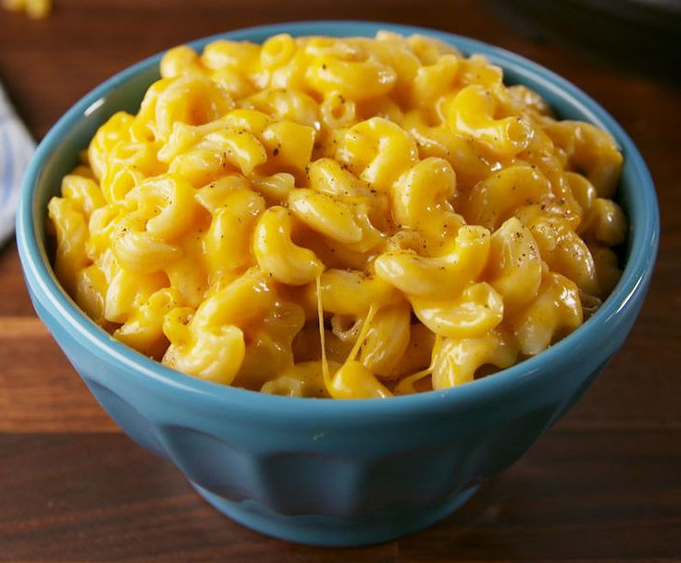


Macros
Macarons
Macaroni
Macron
Mac OS

Slide 3
Announcements
HW6 out, due Tues 8/6
Proj4, Scheme out
  Phase I/II due Mon 8/5
  Whole project due Fri 8/9
  1 EC point by submitting Thurs 8/8 11:59 PM PDT
Midterm Regrades due 8/1

Slide 4
Review: Interpreters & Representing Expressions

Slide 5
Read-Eval-Print Loop (REPL)
Read
Eval
Print
Lexer
expression
representation
value
output
string
input
string
tokens
Parser
“(+ 1 2)”
+
1
2
3
[“(“, “+”, 1, 2, “)”, ]
Pair(“+”, Pair(1, Pair(2, nil)))

Slide 6
Representing Expressions
Demo
In Scheme, we can create lists that “look like” combinations
  In fact, in Scheme, expressions are lists (or primitive values)
Quoting prevents evaluation of an expression
Calling eval on an unevaluated expression will evaluate that value
scm> ‘(+ 1 2)
(+ 1 2)
scm> (eval ‘(+ 1 2))
3
scm> (list 'quotient 10 2)
(quotient 10 2)
scm> (eval (list 'quotient 10 2))
5

Slide 7
Expressions In Scheme

Slide 8
Expressions As Data
Demo
Recall: programs are composed of expressions, but manipulate values or data
In Scheme, expressions are either primitive expressions or lists - which means they’re also a form of data!
This means we can:
Assign expressions to variables
Pass expressions into functions
Create & return new expressions within functions

Slide 9
Begin
Demo
begin is a special form takes in any number of expressions, evaluates them in order, and evaluates to the value of the final expression
(begin 3 2 1)
1
scm> (begin (define x 2) (define x (+ x 1)) x)
3

Slide 10
Let
Demo
(let ((symbol1 expr1)
(symbol2 expr2)
…)
body)
Each symbol is bound to the value of the expression in parallel
The bindings only exist when evaluating the body
Evaluate to the value of the body using the binding
scm> (let ((x 2)
(y 3))
(+ x y))
5

Slide 11
Macros

Slide 12
Example: Double
Demo
Let’s write a procedure double. We want it to evaluate whatever expression we pass in twice.
scm> (double (print 2))
2
2
Issues:
How do we prevent evaluation of the input?
How do we easily get the intended behavior?

Slide 13
Macros
Macros are a more convenient way to transform or create expressions
The define-macro special form will create a macro procedure
Macros take in and return expressions, which are then evaluated in place of the call to the macro
A piece of code that hasn't been evaluated
Equivalent to:
(begin (print 2) (print 2))
(define-macro (twice expr)
(list 'begin expr expr))
scm> (twice (print 2))
2
2
Returns a piece of code that then gets evaluated

Slide 14
Evaluating Macros
Recall evaluation procedure used for regular call expressions:
Evaluate the operator sub-expression, which evaluates to a regular procedure.
Evaluate the operand expressions in order.
Apply the procedure to the evaluated operands.
Macros, on the other hand, do the following:
Evaluate the operator sub-expression, which evaluates to a macro procedure.
Apply the macro procedure to the operand expressions without evaluating them first.
Evaluate the expression returned by the macro procedure in the frame the macro was called in

Slide 15
Break/Q&A

Slide 16
Writing Macros
Demo
Because macros take in and return expressions, when writing macros you should think about:
What types of expressions you’ll take in
What expression has equivalent behavior to your macro
Consider a macro add-to which should take in a symbol and an expression, and increment the value of the variable by the expression.
scm> (define x 1)
scm> (add-to x (+ 1 2))
x
scm> x
4
What’s the equivalent expression?

Slide 17
For Macro
Demo
Scheme doesn't have for loops, but thanks to macros, we can add them.
scm> (for x in '(1 2 3 4) do (* x x))
(1 4 9 16)
scm> (map (lambda (x) (* x x)) '(1 2 3 4))
(1 4 9 16)
(define-macro (for sym in vals do expr)
(list 'map (list 'lambda (list sym) expr) vals))

Slide 18
Quasi-Quotation

Slide 19
Quasi-quoting
Demo
Quasiquotation allows you to have some parts of a list be read literally and some parts be evaluated.
It's especially useful for constructing code in macros.
(define-macro (for sym vals expr)
(list 'map (list 'lambda (list sym) expr) vals))
(define-macro (for sym vals expr)
`(map (lambda (,sym) ,expr) ,vals))
Short for
(quasiquote …)
Short for (unquote …)
Much cleaner, right?
Notes:
Code from Demo:
(define x 2)
'(1 2 3) ; (1 2 3)
(list 1 x 3) ; (1 2 3)
'(1 x 3) ; (1 x 3)
`(1 ,x 3) ; (1 2 3)
'(1 ,x 3) ; (1 (unquote x) 3)
`(1 ,(+ x 5) 3); (1 6 3)

Slide 20
You Try:
Demo
Write the twice and add-to macros using quasiquotes
(define-macro (twice expr)
(list 'begin expr expr))
(define-macro (add-to sym expr)
(list ‘define sym (list ‘+ sym expr)))
Notes:
Code from Demo:
(define x 2)
'(1 2 3) ; (1 2 3)
(list 1 x 3) ; (1 2 3)
'(1 x 3) ; (1 x 3)
`(1 ,x 3) ; (1 2 3)
'(1 ,x 3) ; (1 (unquote x) 3)
`(1 ,(+ x 5) 3); (1 6 3)

Slide 21
(If Time) Fun With Macros
Demo

