Slide 1
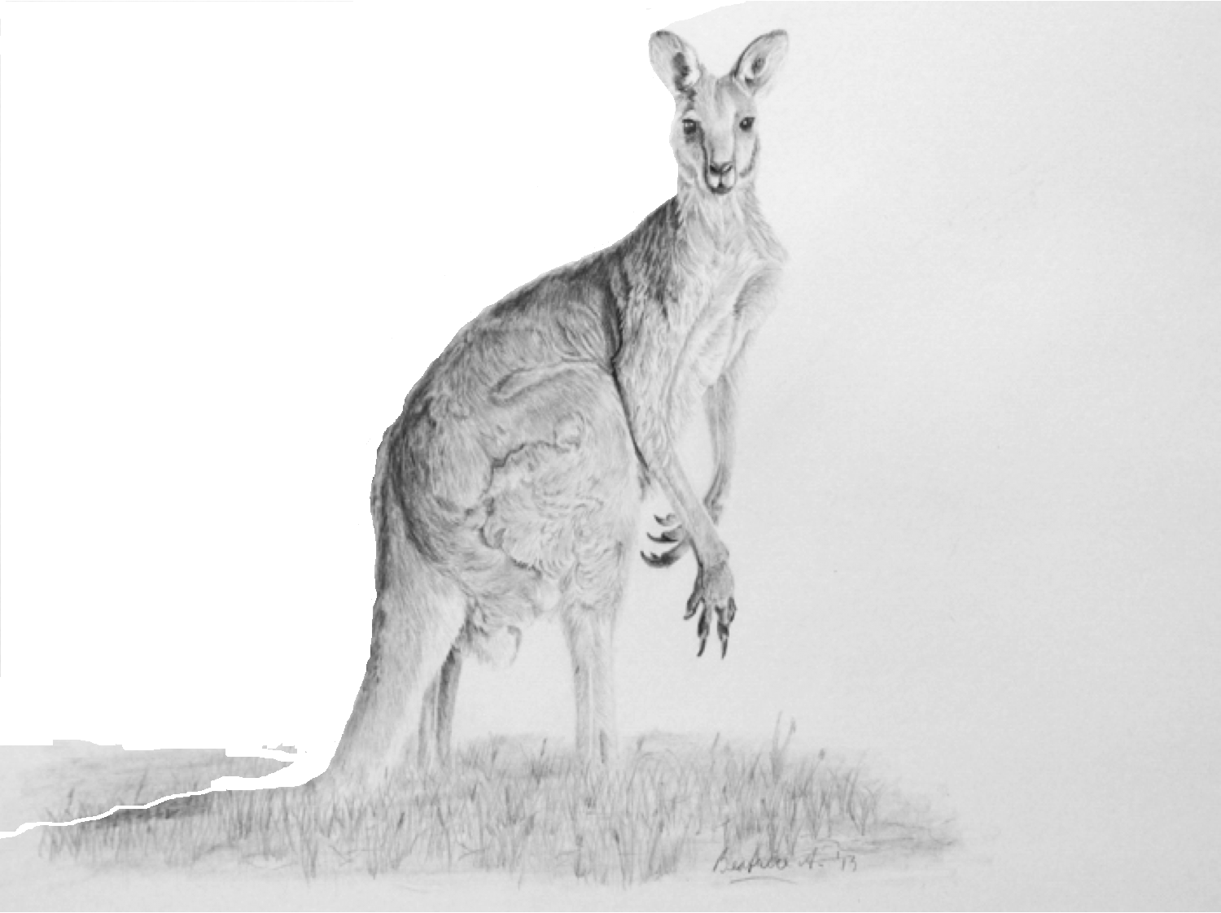
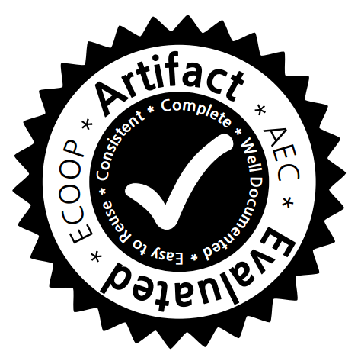

Program Tailoring: Slicing by Sequential Criteria
Yue Li, Tian Tan, Yifei Zhang and Jingling Xue
UNSW Australia
ECOOP 2016
Rome, Italy

Slide 2
Program Slicing
Program slicing
[Weiser 1981] citation: 3950

Slide 3
Program Slicing
Program slicing
[Weiser 1981] citation: 3950
Debugging
Understanding
Analysis
Testing
Verification
…
Maintenance
Optimization

Slide 4
Program Slicing
Program slicing
[Weiser 1981] citation: 3950
Debugging
Understanding
Programming Languages
Analysis
Testing
Verification
Software Engineering
System
Network
…
Maintenance
Optimization
Database
Cryptography & Security
Notes:
Provenance for SQL through abstract interpretation. JVLDB 2015 (relies on slicing and abstract interpretation)
Web service generation through program slicing. International Journal of communications, network and system sciences 2010
Assisted identification of mode of operation in binary code with dynamic data flow slicing. Applied Cryptography and Network Security 2016

Slide 5
Program Slicing
<
>
P, {v1, …}
Criterion

Slide 6
Program Slicing
Control Dependence
Data Dependence
<
>
P, {v1, …}
Criterion

Slide 7
Program Slicing
Control Dependence
Original Program
Data Dependence
Sliced
Program
<
>
P, {v1, …}
Criterion

Slide 8

Program Slicing
Control Dependence
Original Program
Data Dependence
Sliced
Program
<
>
P, {v1, …}
Criterion
Notes:
Now you can see that criterion is the soul of program slciing.
However, in the real-world applications, many clients do not only generate a criterion with only a program point and some related variables,
they also report more interesting information, such as temporal sequence.

Slide 9
Temporal Sequence
Typestate
Analysis
file.open()
file.close()
file.write()

Slide 10
Temporal Sequence
Typestate
Analysis
API Protocol
Analysis
file.open()
A
file.close()
B
file.write()
C

Slide 11
Temporal Sequence
An active research topic !
API
Protocol/Specification
Analysis/Mining
Typestate
Analysis
API Protocol
Analysis
file.open()
A
S&P’13
MSR’15
POPL’02
OOPSLA’08
ICSE’16
FSE’09
MSR’16
file.close()
B
S&P’15
ECOOP’09
ICSE’12
ASE’15
ISSTA’07
FSE’14
S&P’11
file.write()
C
SANER’16
ICSE’10
Rich sources of sequences !

Slide 12

API Protocol
Community
Program Slicing
Community

Slide 13
API Protocol
Community
Program Slicing
Community
Program Slicing
by
a Program Point

Slide 14
API Protocol
Community
Program Slicing
Community
Program Slicing
X
by
a Program Point

Slide 15
API Protocol
Community
Program Slicing
Community
Program Slicing
X
by
a Program Point
Program Slicing
by
a Temporal Sequence

Slide 16
API Protocol
Community
Program Slicing
Community
Program Slicing
X
by
a Program Point
Program Slicing
by
a Temporal Sequence
ECOOP’16
Program Tailoring: Slicing by Sequential Criteria
Notes:
So the question turns to be as what would happen when slicing encounters API protocol analysis?
Program tailoring seems to be a interesting problem, but is it a useful one ? In other words, what can we benefit from program tailoring in practice?

Slide 17
Program Slicing
Notes:
Let us take a program debugging task as an example

Slide 18
Program Slicing

Slide 19
Program Slicing
Notes:
Interprocedural + OO nested heaps → make debugging hard

Slide 20
Program Tailoring
C
Client (typestate)
SC:
A → B → C
(Sequential Criteria)
Notes:
However, in practice, we could get more information about the error as it is reported because it violates some rules say A->B->C.
For example, if the client is a static typestate analysis tool, e.g., open-> close->write

Slide 21
Program Tailoring
C
Client (typestate)
SC:
A → B → C
(Sequential Criteria)

Slide 22
Program Tailoring
C
Client (typestate)
SC:
A → B → C
(Sequential Criteria)

Slide 23
Applications of Program Tailoring

Slide 24
Applications of Program Tailoring

Slide 25
Applications of Program Tailoring

Slide 26
Applications of Program Tailoring

Slide 27
Applications of Program Tailoring

Slide 28
Applications of Program Tailoring

Slide 29
An Observation
Generally, the longer a SC is, the more precise program tailoring would be.

Slide 30
An Observation
Generally, the longer a SC is, the more precise program tailoring would be.
Verification
Typestate
API Protocol
|SC| = 1
|SC| = 2+
|SC| = 3+

Slide 31
Generality of Program Tailoring
Generally, the longer a SC is, the more precise program tailoring would be.
Automatically lengthen ANY given SC soundly, regardless of the given clients?
Verification
Typestate
API Protocol
|SC| = 1
|SC| = 2+
|SC| = 3+

Slide 32
Generality of Program Tailoring
Generally, the longer a SC is, the more precise program tailoring would be.
Automatically lengthen ANY given SC soundly, regardless of the given clients?
Verification
Typestate
API Protocol
|SC| = 1
|SC| = 2+
|SC| = 3+
SC-EXT
(SC Extension)

Slide 33
Overview of Tailor
1
SC-EXT
2
SC-DFA

Slide 34
1
SC-EXT
SC: B → A
SC-EXT
Extended SC:
B → A

Slide 35
1
SC-EXT
SC: B → A
SC-EXT
Extended SC:
B → A

Slide 36
1
SC-EXT
SC: B → A
SC-EXT
Extended SC:
B → A

Slide 37
1
SC-EXT
SC: B → A
SC-EXT
Extended SC:
B → A

Slide 38
1
SC-EXT
SC: B → A
SC-EXT
Extended SC:
new P()//2 → B → A
→
new P()//1

Slide 39
1
SC-EXT
SC: B → A
SC-EXT
Extended SC:
new P()//2 → B → A
→
new P()//1

Slide 40
1
SC-EXT
SC: B → A
SC-EXT
Extended SC:
new P()//2 → B → A
→
new P()//1

Slide 41
1
SC-EXT
SC: B → A
SC-EXT
Extended SC:
new Q() → new P()//2 → B → A
…
→
→ new P()//1

Slide 42
1
SC-EXT
SC: B → A
SC-EXT
Extended SC:
new Q() → new P()//2 → B → A
…
→
→ new P()//1

Slide 43
Overview of Tailor
2
SC-DFA

Slide 44
2
SC-DFA
Intuition

Slide 45
2
SC-DFA
Intuition
Bottom-Up Analysis
Top-Down Analysis

Slide 46
2
SC-DFA
Intuition
Bottom-Up Analysis
Data flow fact for each ICFG node (BU fact):
At runtime, which valid (sub)sequences you may visit in the future
Top-Down Analysis
Data flow fact for each ICFG node (TD fact):
At runtime, which valid (sub)sequences you have visited in the past

Slide 47
2
SC-DFA
SC: A → B → C

Slide 48
2
SC-DFA
SC: A → B → C

Slide 49
2
SC-DFA
SC: A → B → C

Slide 50
2
SC-DFA
SC: A → B → C
[ Bottom-UP Fact ]
+
[ Top-Down Fact ]
=
[ ABC ] ?

Slide 51
2
SC-DFA
SC: A → B → C
Performance
+
Soundness
The real SC-DFA
is a little different
Notes:
Actually, considering some performance and soundness issue, the real SCDFA is little different with this one.
But the basic idea is the same.
For example, when SC is more complicated, the SCDFA designed in our paper is able to reduce the size of the data flow facts in top-down analysis.
In addition, the bottom-up facts should be weakly updated to be sound when the SC is more complicated (e.g., SC: <A-B1-C, A-B2-C>)

Slide 52
Implementation
+
IFDS Framework
Soot
full context-sensitivity and flow-sensitivity

Slide 53
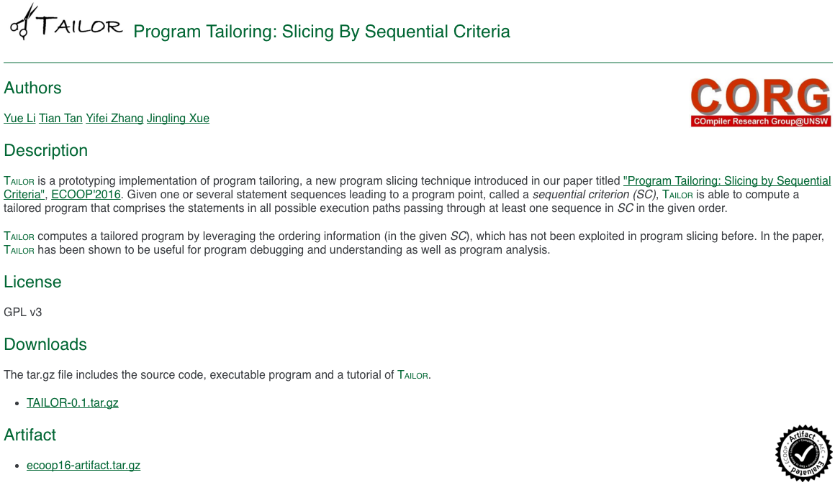
Open-Source Tool
http://www.cse.unsw.edu.au/~corg/tailor
Notes:
Implemented in Soot

Slide 54
Evaluation
TAILOR

Slide 56
Research Questions
RQ1: Is Tailor useful to support debugging and understanding?
RQ2: Is Tailor useful to support program analysis?
RQ3: Is Tailor scalable for large object-oriented programs?

Slide 57










Evaluation

Slide 58
RQ1:
Debugging and Understanding

Slide 59
RQ1: Debugging and Understanding

Slide 60
RQ1: Debugging and Understanding

Slide 61
RQ1: Debugging and Understanding
77 SCs
66 errors & 11 understanding points
Notes:
Emphasize that Thin slicer is already very precise. As mentioned before, in debugging task, even one statement may significantly distract the programmer
affect his patience and make it difficult to accomplish the task.
Use this figure to illustrate again, what thin slicer outputs and how tailor could help.

Slide 62
How Tailor helps Thin Slicer

Slide 63
Performance of Tailor & Thin Slicer

Slide 64
RQ2:
Program Analysis

Slide 65
RQ2:
Program Analysis
(Making precise program analysis more scalable)

Slide 66
RQ2: Program Analysis
SC: forName() → c.getMethod() → m.invoke()

Slide 67
RQ2: Program Analysis
9 SCs
Lead to 9 imprecisely resolved reflective call sites
SC: forName() → c.getMethod() → m.invoke()

Slide 68
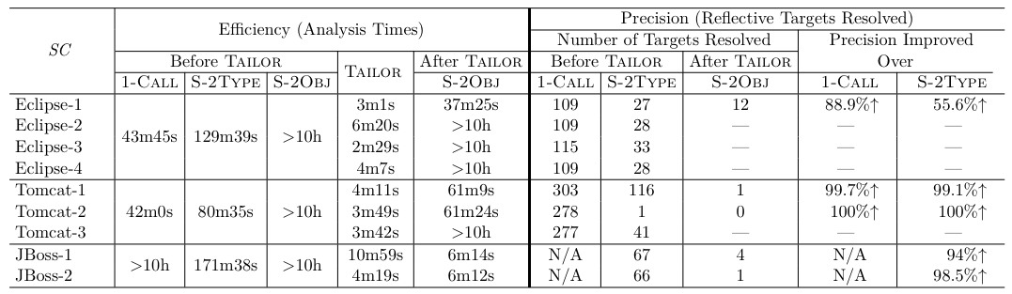
How Tailor helps Program Analysis
hardly scalable but very precise points-to analysis
Traditional slicing is unscalable for these 9 criteria
Notes:
Neither existing slicing techniques nor reflection analysis methods could achieve such good results.

Slide 69
RQ3:
Scalability
“We believe our implementation is fairly well-tuned, as the analysis engine has evolved over several years and …”
“For the larger codes (not large today), our implementation (traditional slicing) could not complete in reasonable time”

Slide 70
RQ3: Scalability
50 x 7 = 350 SCs
SC-EXT
SC-DFA

Slide 71
RQ3: Scalability
50 x 7 = 350 SCs
SC-EXT
SC-DFA
10 minutes

Slide 72
RQ3: Scalability
Tomcat
eclipse
PMD
ANTLR
Avrora
FOP
JBoss

Slide 73
Conclusions

Slide 74
Program
Slicing
API protocol
Mining
TAILOR
Program
Analysis
Other
Applications

Slide 75
Program
Tailoring
Notes:
Give some sequences and we may tailor a different world for you

Slide 76

Thank You
Yue Li
ECOOP 2016 @
Rome, Italy
UNSW Australia

Slide 77

Challenges
Precision
Generality
Scalability

Slide 78
Challenges
Precision
Unrealizable Paths
X
K-CFA
Full context- and flow-sensitive analysis
Program Tailoring
IFDS Problem
Encode control flows as data flow facts
Notes:
Interprocedual, finite, distributive subset problem
Encode control flows as data flow facts and then feed these facts to the IFDS solver to resolve

Slide 79
Challenges
Scalability
“We believe our implementation is fairly well-tuned, as the analysis engine has evolved over several years and …”
“For the larger codes (not large today), our implementation (traditional slicing) could not complete in reasonable time”
“The key bottleneck comes from handling heaps; … heap parameters are also a scalability bottleneck in a commercial slicing tool”
Need a good trade-off between Precision and Scalability
Notes:
Precision+Scalability

Slide 80
Challenges
Generality
Generally, the longer of the length of a SC, the more precise program tailoring would be.
Automatically lengthen ANY given SC, and also maintain the soundness and scalability of program tailoring ?
Verification
Typestate
API Protocol
|SC| = 1
|SC| = 2
|SC| = 3+
Notes:
In other words, what benefits could be brought by generality ? Say it in simple words as a motivation at the end.

Slide 81
Challenges
Precision
SC-DFA
Scalability
TAILOR
Generality
SC-EXT

Slide 82

Motivation of RQ2
highly scalable but imprecise
Original Program
Points-To
Analysis
hardly scalable but very precise
Tailored program
(SC-relevant part)
Reflection
Analysis
SC: forName() → c.getMethod() → m.invoke()
Notes:
Reflection analysis is very important as a fundamental analysis, as
Imprecise reflection analysis may introduce too many false call graph edges and make its client too imprecise to be useful or even unscalable.

Slide 83
RQ2: Program Analysis

